Slide 1
Planetary Protection Guidelines Satellite data machine learning
May 1, 2019
By: ZiAng Zhang , Madelaine Davis, ahmeda

Slide 3
Front end (output)
Front end (input)
Front page with Leaflet map
Needs: JavaScript, Leaflet.js, flask, Heroku (maybe?)
Satellite data pulled from API
Needs: Python, Planet.com API, module asteroid (for converting pictures into numbers)
Calculating results
Needs: JavaScript, Tableau
Front page with visualization of results
Needs: Python, Machine Learning, some simple formulas like NDVI
AWS (if there’s large amount of data/computing)
④
①
③
②
Back end (ML)
Back end (getting data)

Slide 4
References
https://www.youtube.com/watch?v=txhjhjWqF7c
https://github.com/planetlabs/notebooks
For pulling satellite data from API:
/notebooks/jupyter-notebooks/data-api-tutorials/search_and_download_quickstart.ipynb
For visualizing:
/notebooks/jupyter-notebooks/getting-to-know-sat-imagery/Inspecting_Satellite_Imagery.ipynb

Slide 5
Planetary Protection Basics
Basic working definition - Mitigating the risks associated with microbial and organic cross-contamination, including:
Preservation of planetary conditions for future biological and organic constituent exploration
Considered ‘forward contamination’
Protecting Earth and its biosphere from potential extraterrestrial sources of contamination
Considered ‘backward contamination’
Human-Assisted Sample Return includes another element:
Protecting human crews from exposure to unknown life forms that may be hazardous

Slide 6
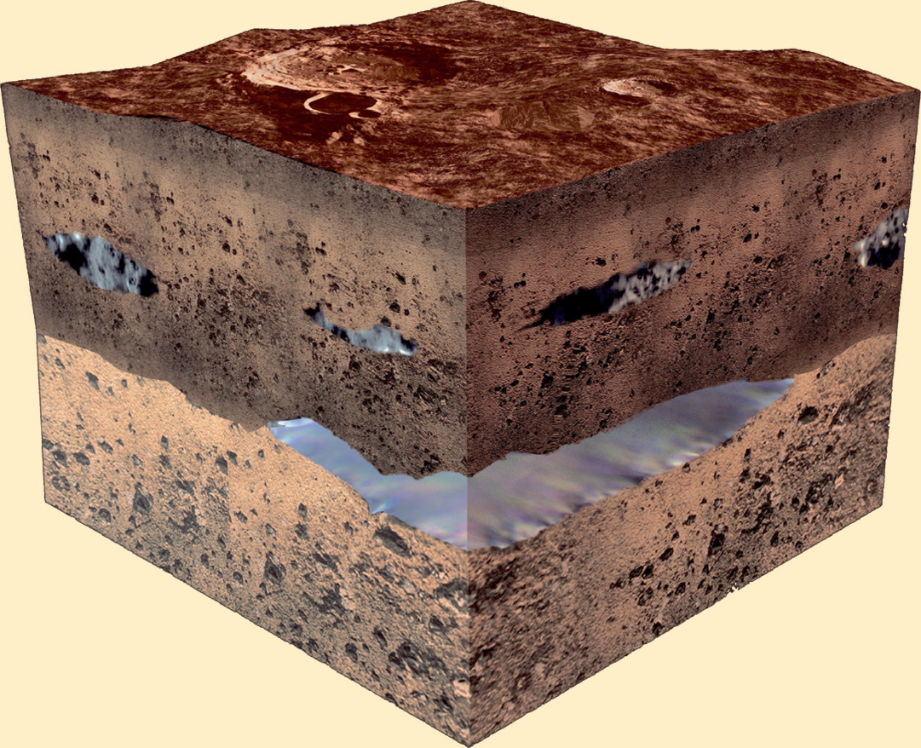
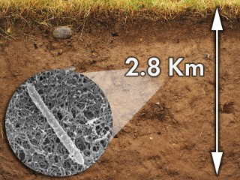

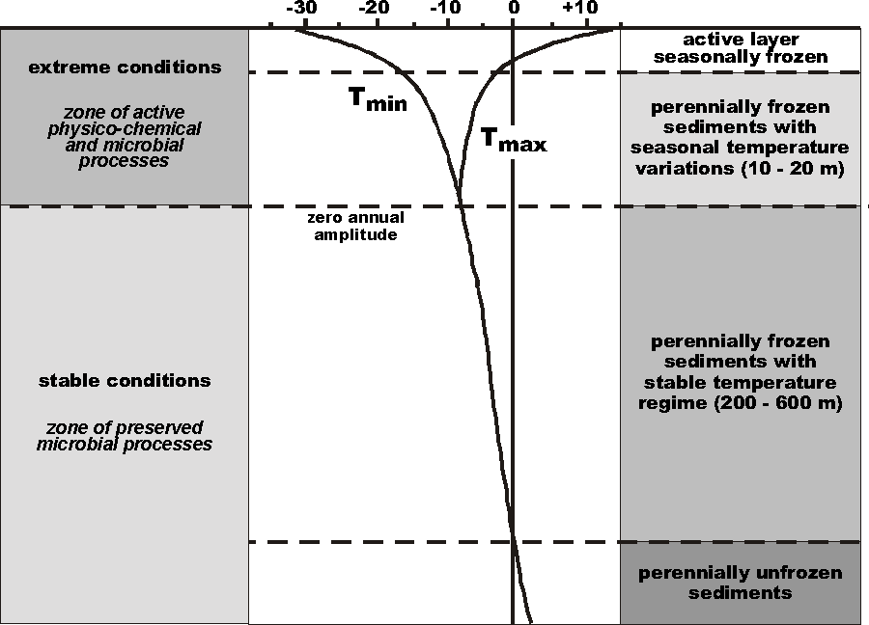
Life is Everywhere…
Low temperature environments
Deep subsurface
Up to 10⁷ cells/g in 60m depth, with metabolic activity down to -20°C
Cryptoendoliths
-10 °C
Desulforudis audaxviator

Slide 7
Process / Analyze
Analysis of data is a process of inspecting, cleaning, transforming, and modeling data with the goal of discovering useful information, suggesting conclusions, and supporting decision-making.
Supports:
Interactive dashboards → Interactive analytics
Weekly reports → Batch analytics
Deal Manager Business Process – As-Is reporting
Notes:
Analysis of data is a process of inspecting, cleaning, transforming, and modeling data with the goal of discovering useful information, suggesting conclusions, and supporting decision-making.
Examples:
Data Warehousing: Monthly bill, Interactive dashboards
Machine Learning: Sentiment Analysis, Prediction
Stream processing: Alerts, 1 minute metrics, etc.
http://www.jmlr.org/papers/volume9/li08a/li08a.pdf
Forecasting Web Page Views:
http://nlp.stanford.edu/sentiment/
http://nlp.stanford.edu/sentiment/Methods and Observations
https://en.wikipedia.org/wiki/Data_analysis

Slide 8
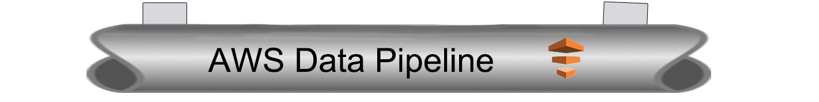
Design Patterns
ETL
Store
Analyze

Slide 9
















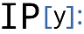
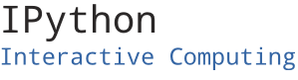



Machine Learning Infustructure and Frameworks
Collect
Store
ETL
Analyze
Consume
A
Amazon
ElastiCache
Hot
Amazon Redshift
Amazon
QuickSight
Web Apps
Applications
Amazon DynamoDB
Interactive
Analysis & Visualization
Search SQL NoSQL Cache
AWS
Lambda
Fast
Transactional Data
Amazon RDS
Amazon
ES
Warm
Amazon Elastic MapReduce
S3
Search Data
Hot
Batch
Slow
Notebooks
Cloud watch
File Storage
Amazon S3
Logging
File Data
Fast
AWS Datapipeline
Cold
IDE
Apps & APIs
Interactive Analytics
Amazon Redshift, Spark
Batch Processing
EMR , Hive, Spark, Lambda
Analysis Tools and Frameworks

Slide 10
ETL Data Model
Needs to supports both primitive SQL types (boolean, integer, double, decimal, string, data, timestamp) and complex types (structs, arrays, maps, and unions); also user defined types.
First class support for complex data types

Slide 11
Flow chart
Amazon Redshift
Tables combined
sources
Normal Load Process
Sentnal satilite API
Need to be Re-process to create Tables
Amazon RedShift
Process Table
Amazon S3
Orbritor salitlite API
Amazon EMR
process
Spark
Hive
store
Datapieline
Batch

Slide 12
Multi-Stage “Data Bus”
Multiple stages
Storage decoupled from processing
Currently there are 12 levels of temp stages/store
That should run in parallel and get inserted into the finalized table.
SQL available upon request…
Data
Unified Table
Store
Process
Store
Process
Data
Notes:
Similar to multi-tier web-app-data architectures
Concept of a “data bus” or “data pipeline”

Slide 13
Plan Optimization & Execution
e.g. Pipeline projections and filters into a single map
Analysis
Logical
Optimization
Physical
Planning
Code
Generation
SQL AST
Unresolved Logical Plan
Logical Plan
Optimized Logical Plan
Physical Plans
Selected Physical Plan
RDDs
Cost Model
DataFrame
DataFrames and SQL share the same optimization/execution pipeline

Slide 14
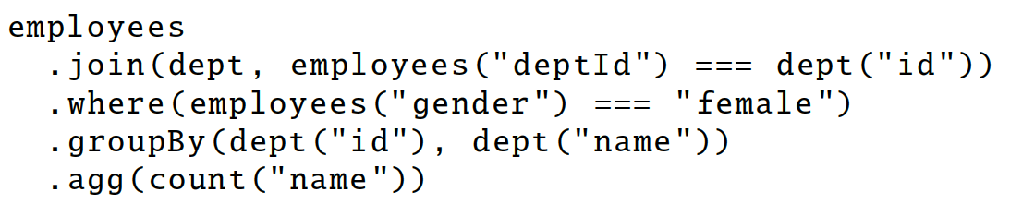
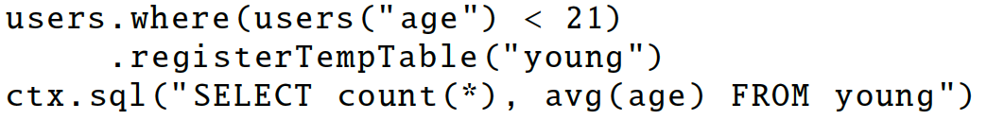
DataFrame Operations
Relational operations (select, where, join, groupBy) via a DSL
Operators take expression objects
Alternatively, register as temp SQL table and perform traditional SQL query strings
Notes:
traditional sql convenient for computing multiple things at the same time

Slide 15
DataFrame
A distributed collection of rows organized into named columns.
An abstraction for selecting, filtering, aggregating and plotting structured data (cf. R, Pandas).
Archaic: Previously Schema RDD (cf. Spark < 1.3).

Slide 16
def add_demographics(events):
u = sqlCtx.table("users") # Load partitioned Hive table
events \
.join(u, events.user_id == u.user_id) \ # Join on user_id
.withColumn("city", zipToCity(df.zip)) # Run udf to add city column
events = add_demographics(sqlCtx.load("/data/events", "parquet"))
training_data = events.where(events.city == "Melbourne").select(events.timestamp).collect()
Logical Plan
Physical Plan
Physical Plan
with Predicate Pushdown and Column Pruning
filter
join
join
join
scan
(events)
filter
optimized
scan
(events)
optimized scan
(users)
events file
users table
scan
(users)

Slide 17


Improvement upon Existing Art
Engine does not understand the structure of the data in RDDs or the semantics of user functions → limited optimization.
Can only be used to query external data in Hive catalog → limited data sources
Can only be invoked via SQL string from Spark→ error prone
Hive optimizer tailored for MapReduce → difficult to extend

Slide 18


Write Less Code: Compute an Average
private IntWritable one =
new IntWritable(1)
private IntWritable output =
new IntWritable()
proctected void map(
LongWritable key,
Text value,
Context context) {
String[] fields = value.split("\t")
output.set(Integer.parseInt(fields[1]))
context.write(one, output)
}
IntWritable one = new IntWritable(1)
DoubleWritable average = new DoubleWritable()
protected void reduce(
IntWritable key,
Iterable<IntWritable> values,
Context context) {
int sum = 0
int count = 0
for(IntWritable value : values) {
sum += value.get()
count++
}
average.set(sum / (double) count)
context.Write(key, average)
}
data = sc.textFile(...).split("\t")
data.map(lambda x: (x[0], [x.[1], 1])) \
.reduceByKey(lambda x, y: [x[0] + y[0], x[1] + y[1]]) \
.map(lambda x: [x[0], x[1][0] / x[1][1]]) \
.collect()

Slide 19
Write Less Code: Compute an Average
Using RDDs
data = sc.textFile(...).split("\t")
data.map(lambda x: (x[0], [int(x[1]), 1])) \
.reduceByKey(lambda x, y: [x[0] + y[0], x[1] + y[1]]) \
.map(lambda x: [x[0], x[1][0] / x[1][1]]) \
.collect()
Using SQL
SELECT name, avg(age)
FROM people
GROUP BY name
Using DataFrames
sqlCtx.table("people") \
.groupBy("name") \
.agg("name", avg("age")) \
.collect()

Slide 20
Seamlessly Integrated
Embedding in a full programming language allows composition using functions.
zipToCity = udf(lambda city: <custom logic here>)
def add_demographics(events):
u = sqlCtx.table("users")
events \
.join(u, events.user_id == u.user_id) \
.withColumn("city", zipToCity(df.zip))
Takes and returns a DataFrame

Slide 21
Design of Hadoop Distributed File System (HDFS)
Master-Slave design
Master Node
Single NameNode for managing metadata
Slave Nodes
Multiple DataNodes for storing data
Other
Secondary NameNode as a backup

Slide 22

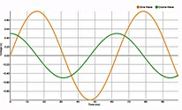
Future Research … Real-time Analytics
Amazon
SNS
KCL
Alert
Notifications
Amazon Kinesis
AWS Lambda
Amazon
ElastiCache (Redis)
Producer
DynamoDB Streams
Spark
Streaming
App state
Amazon
DynamoDB
Apache
Storm
Amazon
RDS
KPI
Amazon
ES
Real-time Prediction
process
store
Amazon
ML
Notes:
Best practices
BDT318 - Netflix Keystone: How Netflix Handles Data Streams Up to 8 Million Events Per Second
Use Kinesis or Kafka for stream storage
Use appropriate stream processing tool
KCL – Simple, only for Kinesis
Apache Storm – general purpose
Spark Streaming – Windowing, MLlib, Statefull
AWS Lambda – fully managed, no servers, stateless
Use Amazon SNS for Alerts
Use Amazon ML for predictions
Use a managed database/cache for state management
Use a visualization tool for KPI visualization

Slide 23
Summary
Build decoupled “data bus”
Data → Store ↔ Process → Answers
Use the right tool for the job
Latency, throughput, access patterns
Use Lambda architecture ideas
Immutable (append-only) log, batch/speed/serving layer
Be cost conscious
Big data ≠ big cost
Notes:
Before we go into solving the Big architecture, I want to introduce some “tried and test” architecture principles.
Here at AWS we believe you should be using the right tool for the job – “instead of using a big swiss army knife for using a screw dreive, it will be best to use a screw drive - this is especially important for big data architectures. We’ll talk about this more.
Decoupled architecture http://whatis.techtarget.com/definition/decoupled-architecture - In general, a decoupled architecture is a framework for complex work that allows components to remain completely autonomous and unaware of each other…this has been tried and battle test.
Managed services – this is relatively now - Should I install Cassandra or MongoDB or CouchDB on AWS. You obviously can. Sometimes there are good reasons for doing this. Many customers still do this. Netflix is a great example. They run a multi-region Cassandra and are a poster child for how to do this. But for most customers, delegating this task to AWS makes more sense….you are better of spending your time on building features for your customers rather than building highly scalable distributed systems.
Lambda Architecture -

